Slide 1
FINGER PRINT BASED EXAM HALL AUTHENTICATION
PRESENTED By :
DHANUSYA. S (22ai012)
Prassannaa .S .M (22ai038)
Rohini. R (22ai042)
Guided By :
Dr. K. Lalitha,
Prof Ai&Ds
TEAM NO : 11
22AIC14 : Internet of Things & It’s Application

Slide 2
Abstract
A fingerprint-based authentication system for exam hall access, designed to enhance security and efficiency. Using a fingerprint sensor and an Arduino microcontroller, the system verifies candidates’ identities by comparing scanned fingerprints with pre-registered data.
If the fingerprint matches, the door automatically unlocks, allowing entry to the exam hall, while an LCD screen provides real-time feedback. If access is denied, the system remains locked and displays a message on the LCD.
This automated process eliminates manual verification, reduces fraud, and streamlines the entry procedure. The system is scalable, cost-effective, and ensures a secure, fair, and efficient exam environment.

Slide 3
Objectives:
Enhance Security: To prevent unauthorized access to the exam hall by using fingerprint-based biometric authentication, ensuring only registered candidates are granted entry.
Real-Time Verification: To provide real-time feedback on the LCD display, indicating whether access is granted or denied, based on the fingerprint comparison.
User-Friendly Experience: To create an intuitive and straightforward process for both candidates and exam administrators, ensuring a seamless and secure examination process.
Automation of Access Control: To automate the exam hall entry process by integrating a fingerprint sensor, servo motor, and Arduino microcontroller, eliminating the need for manual checks.

Slide 4
Components Required:
Arduino Uno or compatible board
Adafruit Fingerprint Sensor (R307)
Servo Motor (for locking/unlocking the door)
IR Sensor (for detecting when a candidate is standing in the designated mark)
16x2 LCD Display (to show messages)
Jumper Wires
Power Supply (USB or external adapter)

Slide 5
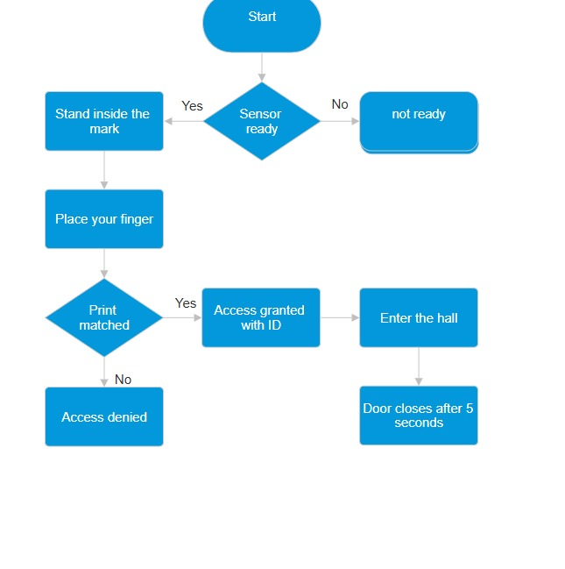
Flow Diagram:

Slide 6
Implementation: Both hardware & software
HARDWARE :
Fingerprint Sensor (R307):
TX of Fingerprint Sensor to RX of Arduino (pin 3)
RX of Fingerprint Sensor to TX of Arduino (pin 2)
Servo Motor:
Signal wire to pin 9 on the Arduino
IR Sensor:
Sensor pin to Arduino pin 10
LCD:
16x2 LCD (RS to pin 12, EN to pin 11, D4 to pin 6, D5 to pin 7, D6 to pin 5, D7 to pin 4)

Slide 7
Implementation: Both hardware & software
SOFTWARE :
Arduino IDE
Libraries Required:
LiquidCrystal: Controls the LCD display.
Adafruit_Fingerprint: Manages communication with the
fingerprint sensor.
Servo: Controls the servo motor for locking/unlocking the
door.
SoftwareSerial: Handles communication between the Arduino
And Fingerprint sensor using different serial pins.

Slide 8
THANK YOU

